Slide 1
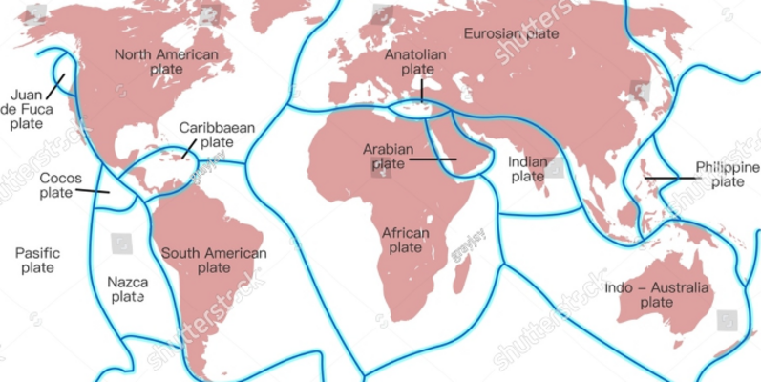
2023 Earthquakes Analysis
IE6600 Computation And Visualization for Analytics
Group 1
By Aishwarya Belakavadi Subrahmanya, Haodong Liu, Naveen Dhanasekaran, Yizhe Liu, Ziyue Yin

Slide 2
Innovation & Motivation
Real-World Problem
Focus on the significance of earthquake data in understanding serious seismic activity and the significance of statistics can provide future prediction and preparedness.
Statistical Challenge
Exploratory of the relationships based on the past earthquake’s magnitude, depth and latitude/longitude can be summarized and visualized using different statistical analyses.
Predictive Analysis
Using advanced Machine Learning techniques to model the prediction of seismic activity based on historical earthquakes data for future application.

Slide 3
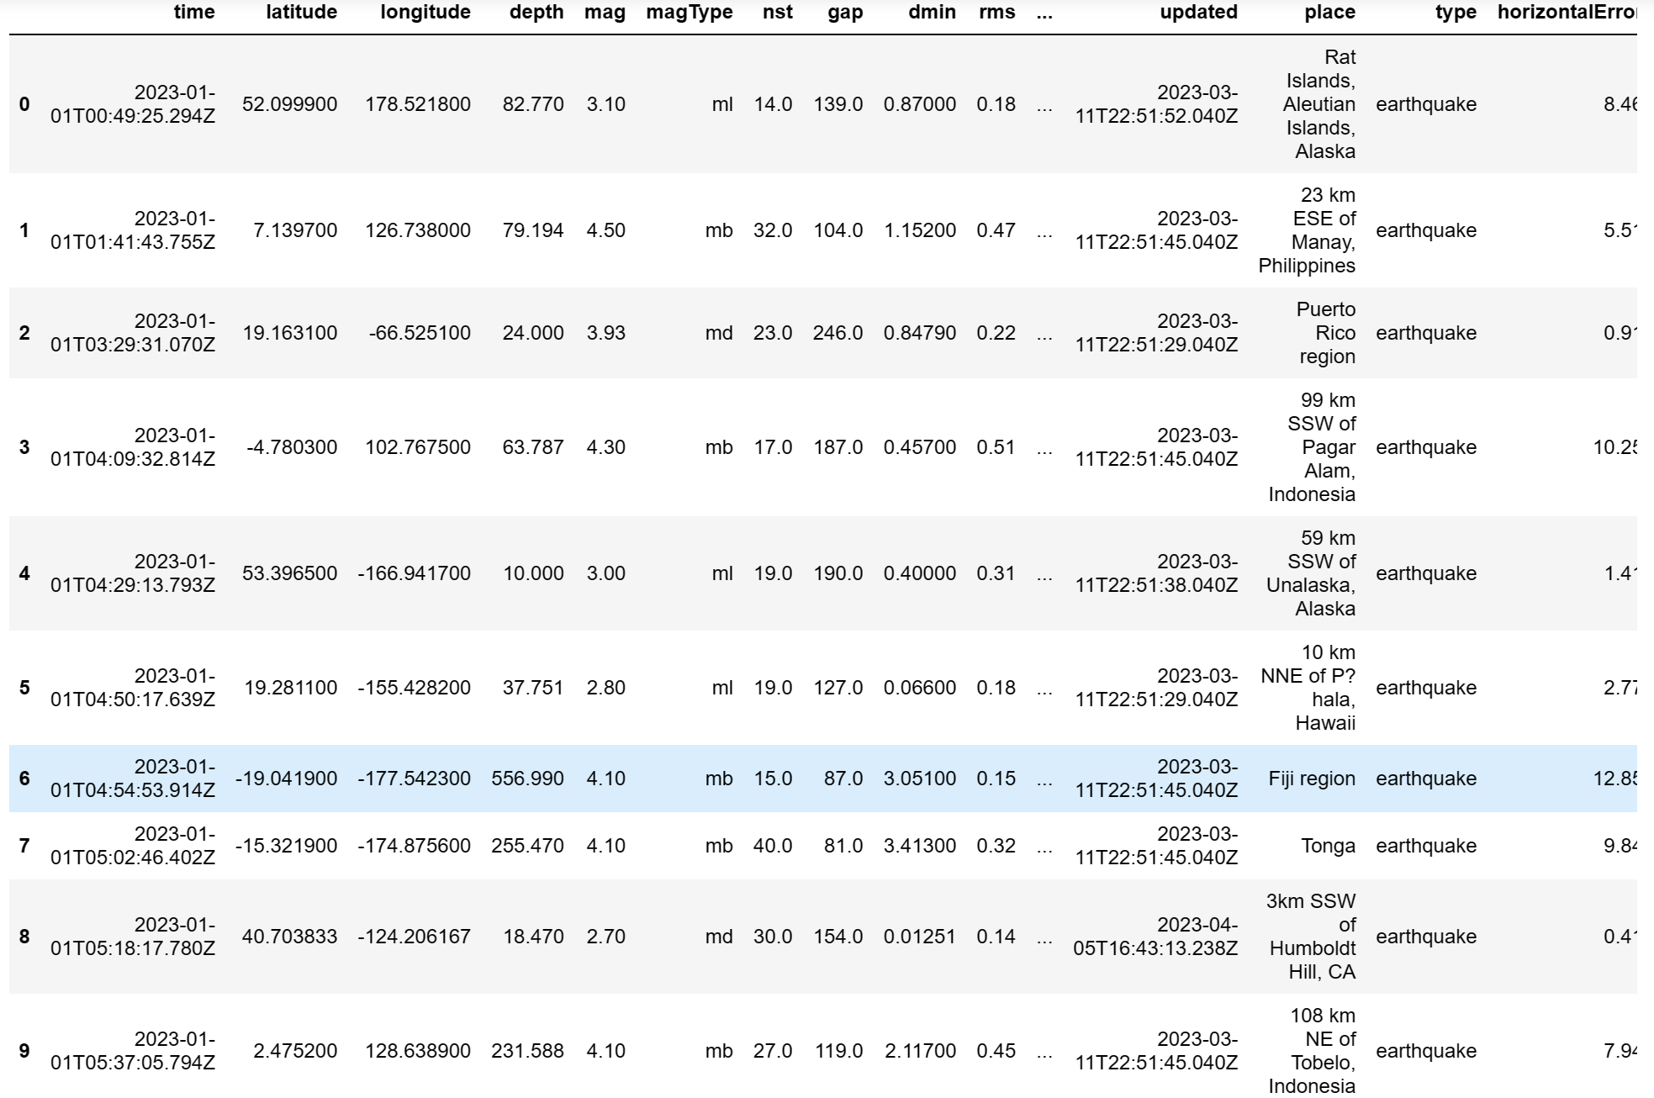
Data Inspection
The dataset has:
22 columns: the main attributes should be time, latitude, longitude, depth, magnitude, place, etc.
26642 rows: the total number of the earthquakes data containing in the dataset.

Slide 4
Data Processing & Cleaning
Harmonize Format
Using pd.to_datetime() to change the time format for ease of use.
Deal with Null Value
Using isna() function detect the numerical null value and process the null value with the mean() function to fulfill the null blank in the dataset.
Using same isna() function detect the null value and replace it with the uniformed str value “Unknown”.
Further Actions
Replace the duplicate rows and value in the earthquakes dataset avoid duplicate values affecting subsequent analysis
Detect the outlier value and filter out the row that was identified as the outlier value.

Slide 5
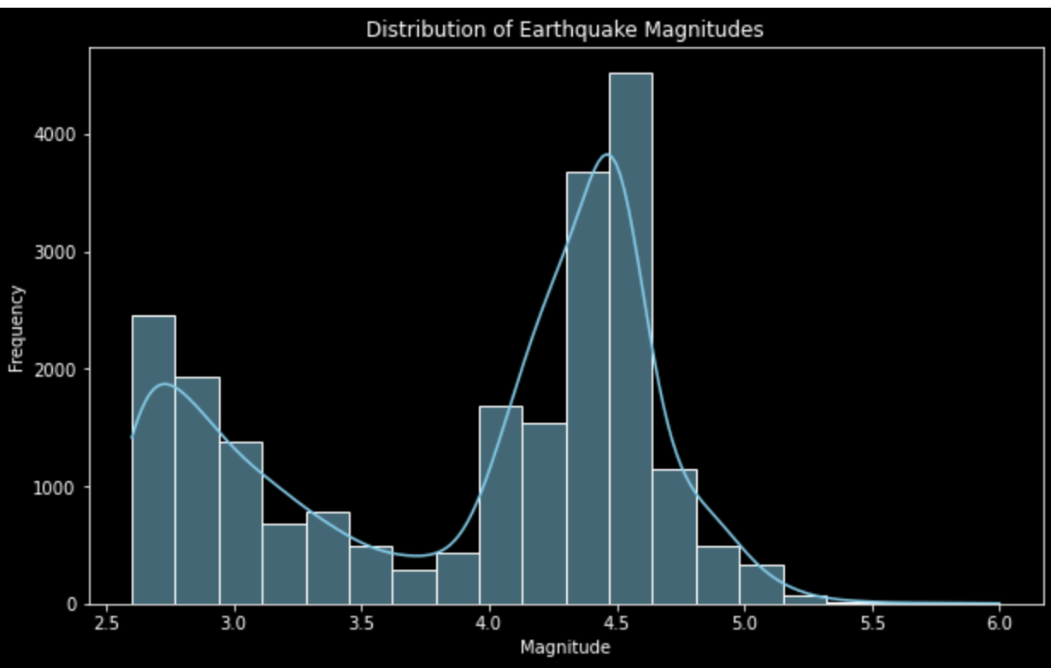
Exploratory Data Analysis & Visualization (EDA)
This is a histogram and KDE plot to visualize the distribution of earthquake magnitudes. The dark background style, along with the specified color and labels, enhances the clarity of the plot. The visualization allows you to see the frequency distribution of earthquake magnitudes and observe any patterns or trends in the data. The earthquake with magnitude 4.5 happens most frequently.

Slide 6
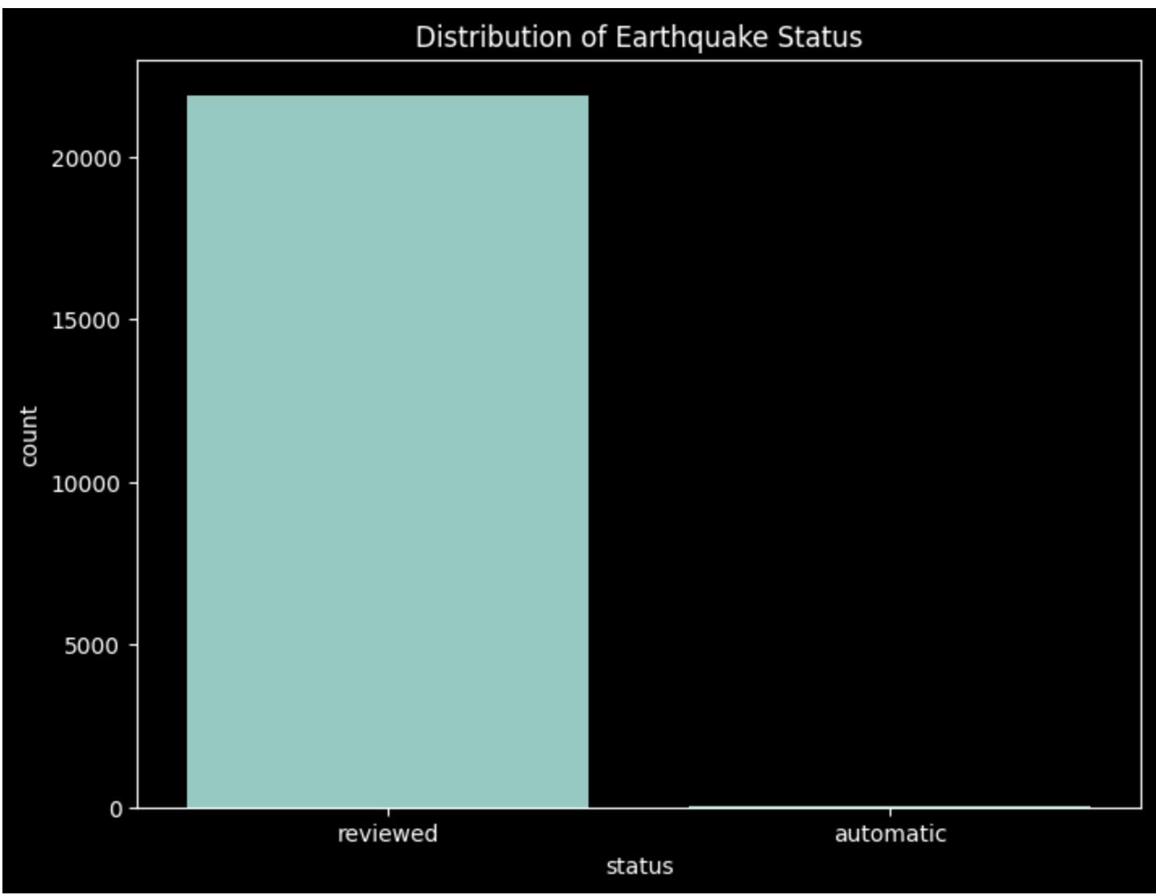
Earthquake Status Distribution
This is the bar chart compared the reviewed and automatic earthquakes status. From this graph, There are only reviewed status in the dataset.

Slide 7
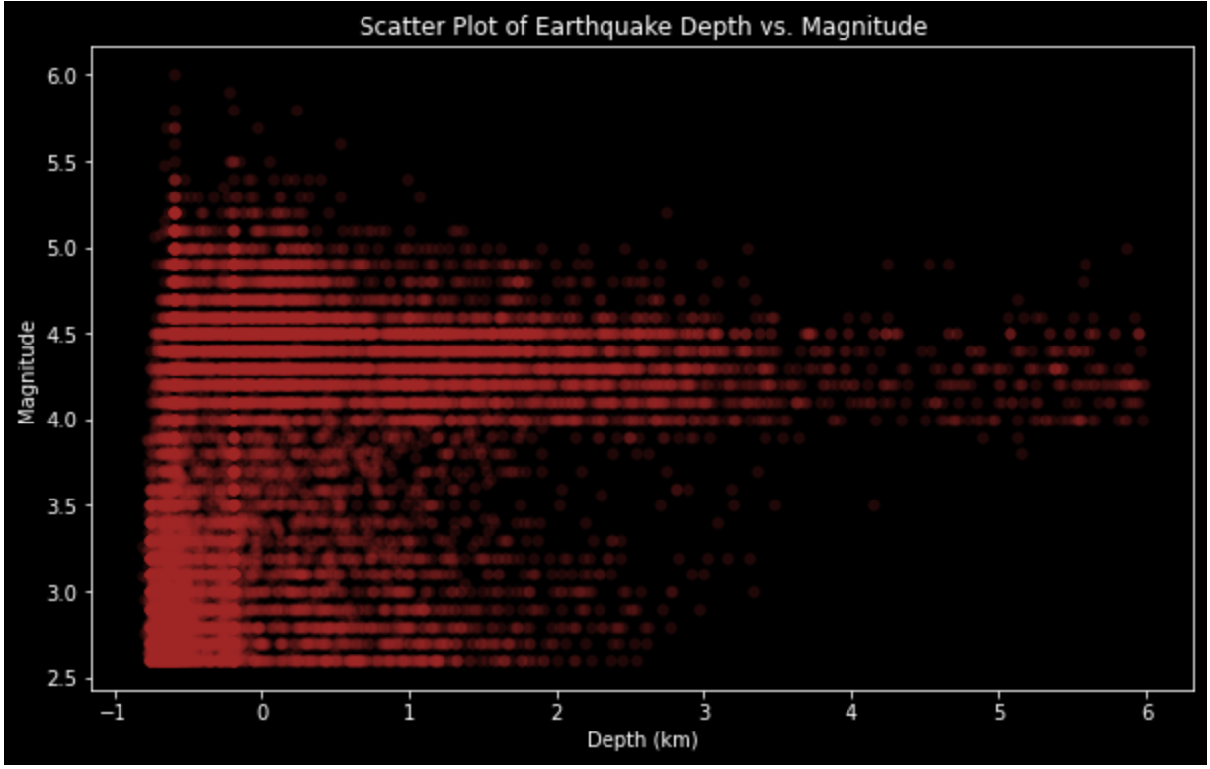
Scatter plot of earthquake depth vs. magnitude
This is a scatter plot to explore the relationship between earthquake depth and magnitude. The plot allows you to visually examine if there is any correlation or pattern between these two variables. The use of transparency helps in identifying density in specific regions of the plot. From this graph, most earthquakes happen at the depth between 0 and -1 and focus at the magnitude at 4.5.

Slide 8
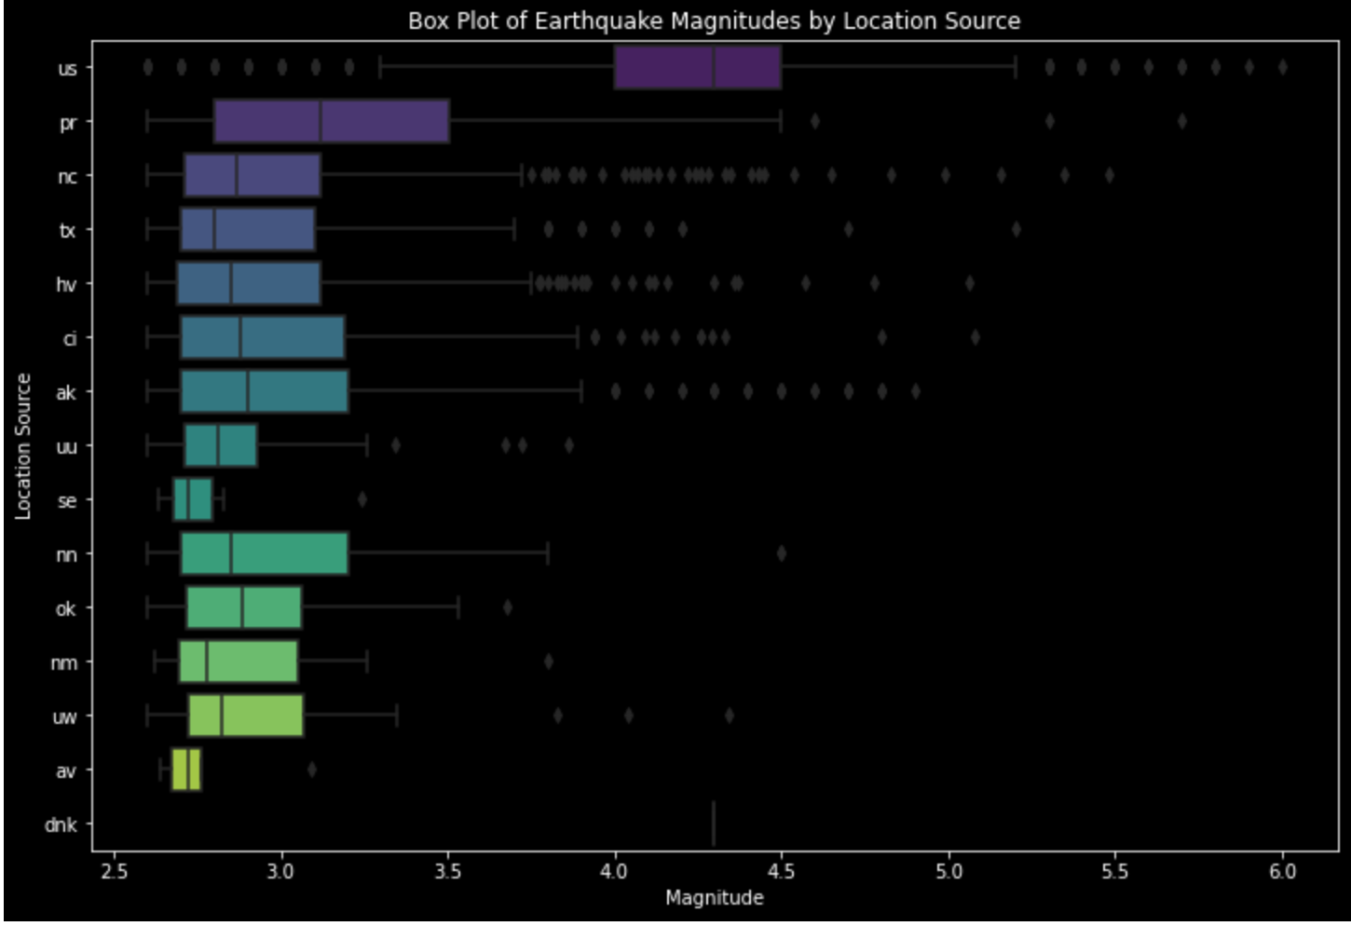
Box plot of earthquake magnitudes by location source
This is a box plot to compare the distribution of earthquake magnitudes across different location sources. The plot allows you to identify variations in magnitude based on the source of earthquake location information, providing insights into the seismic activity reported by different sources. From this graph, we can see the magnitude statistics of earthquakes

Slide 9
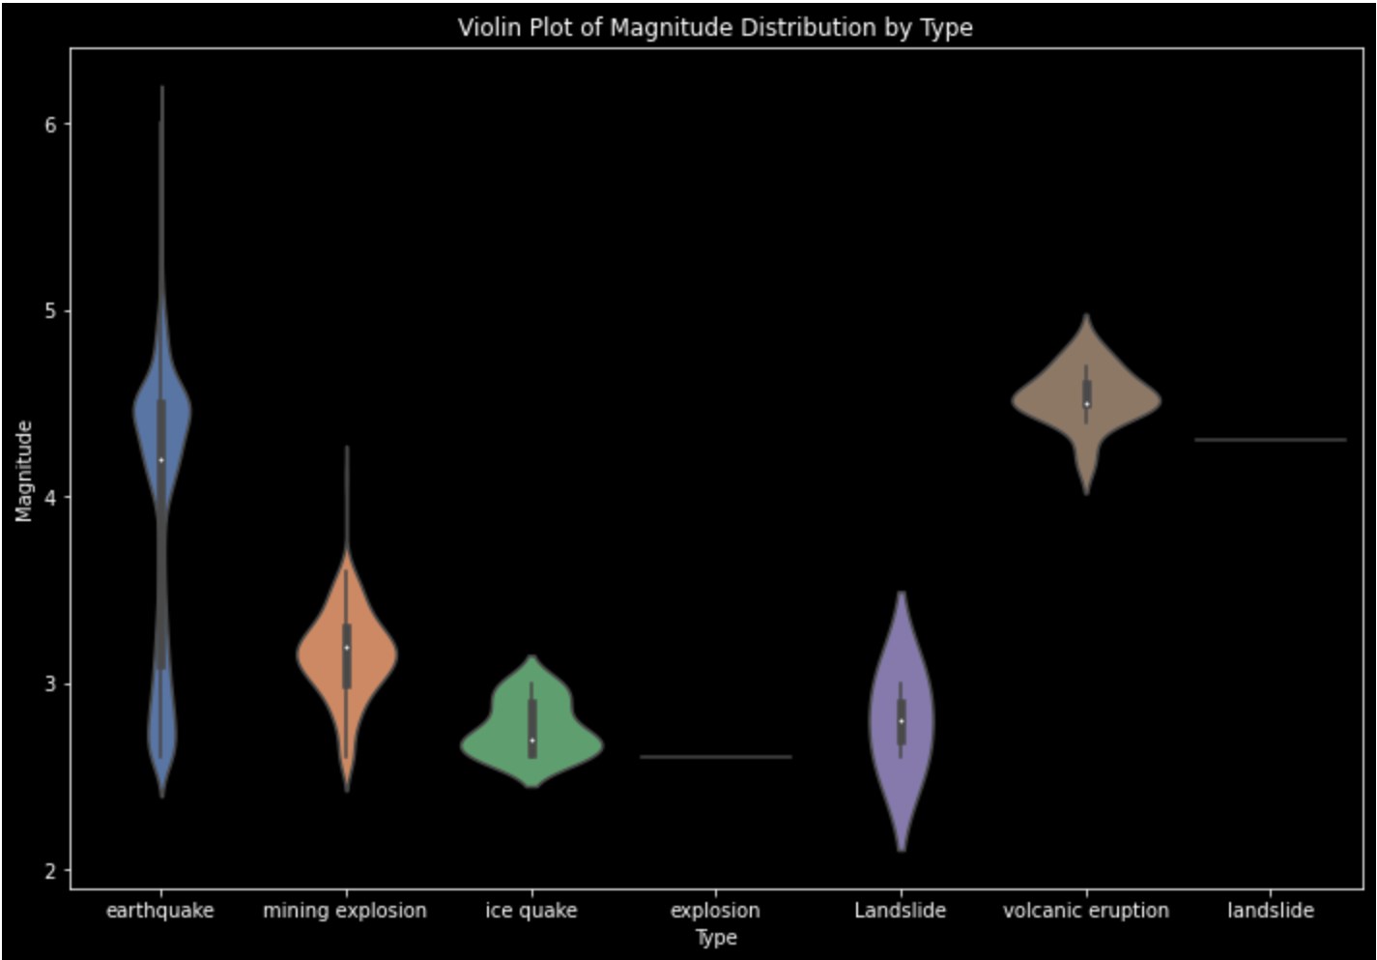
Violin Plot of Magnitude Distribution by Type
The output graph illustrates a violin plot depicting the distribution of earthquake magnitudes for different types of earthquakes.
Each violin displays the distribution of earthquake magnitudes (y='mag'). The width of the violin at different points represents the density of magnitude values, providing insights into the distribution's shape.

Slide 10
Violin Plot of Magnitude Distribution by Type
Observations that can be done from the violin plot-
The width of the violins at different magnitudes indicates the density of occurrences at those magnitudes. Wider sections suggest higher density, while narrower sections indicate lower density.
Points outside the violins represent outliers—magnitude values that deviate significantly from the typical distribution.
The shapes of the violins shows the variations in magnitude distributions.

Slide 11
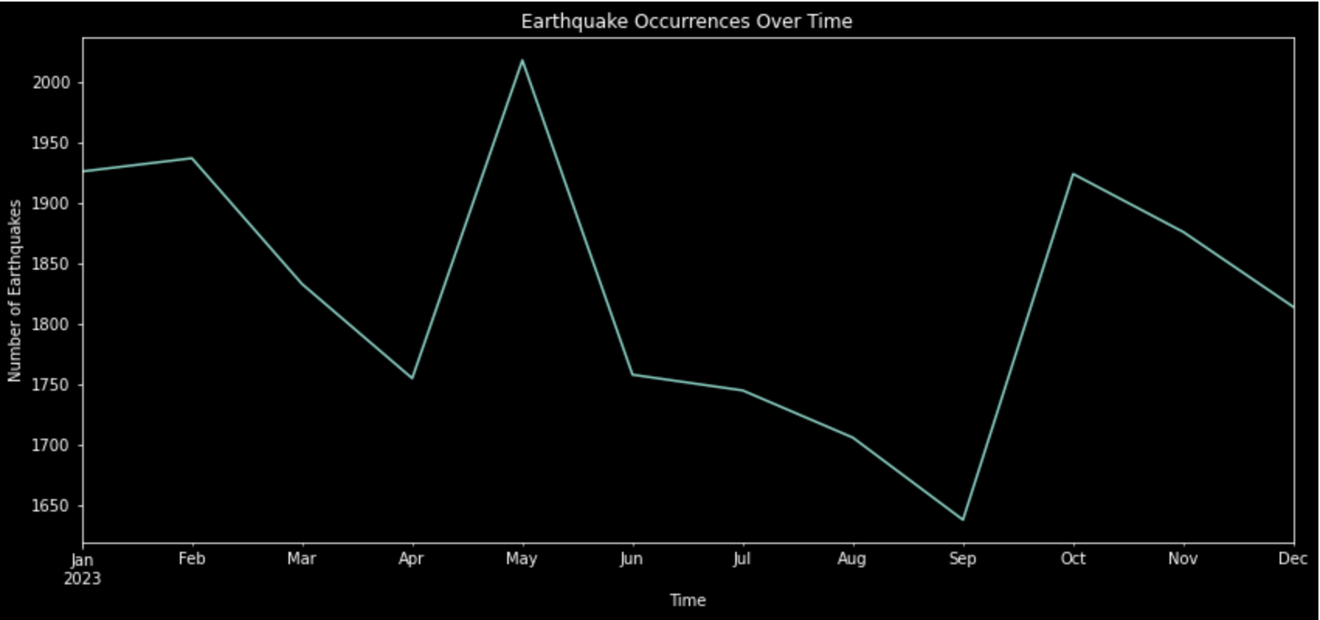
Time series plot of earthquake occurrences over time
This graph converts the 'time' column to datetime format, sets it as the index, and then creates a time series plot showing the number of earthquakes per month over time. The plot provides insights into the temporal distribution of earthquake occurrences. From this graph, earthquakes happen most frequently in May.

Slide 12
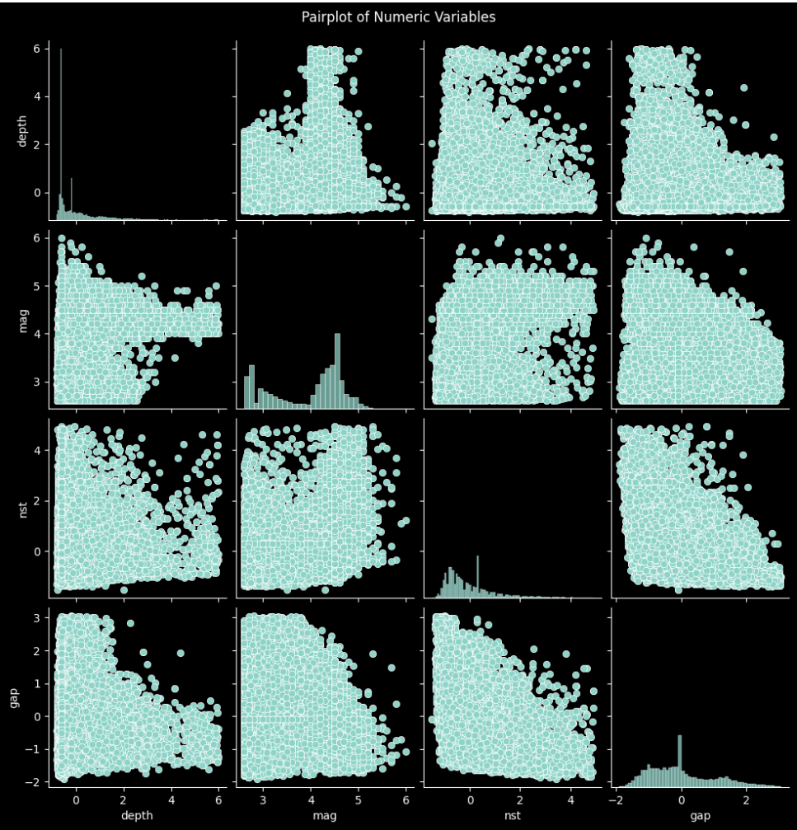
Pairplot
The output graph presents a pairplot of selected numeric variables from the earthquake dataset.
The pairplot displays scatterplots for each pair of numeric variables selected from the dataset ('depth', 'mag', 'nst', 'gap'). The diagonal shows histograms for each individual variable.
In the lower triangle of the pairplot, each point represents a data point, and the scatterplots show the relationship between two variables.
The histograms on the diagonal represent the distribution of each individual variable. They provide insights into the range and frequency distribution of values for each variable.

Slide 13
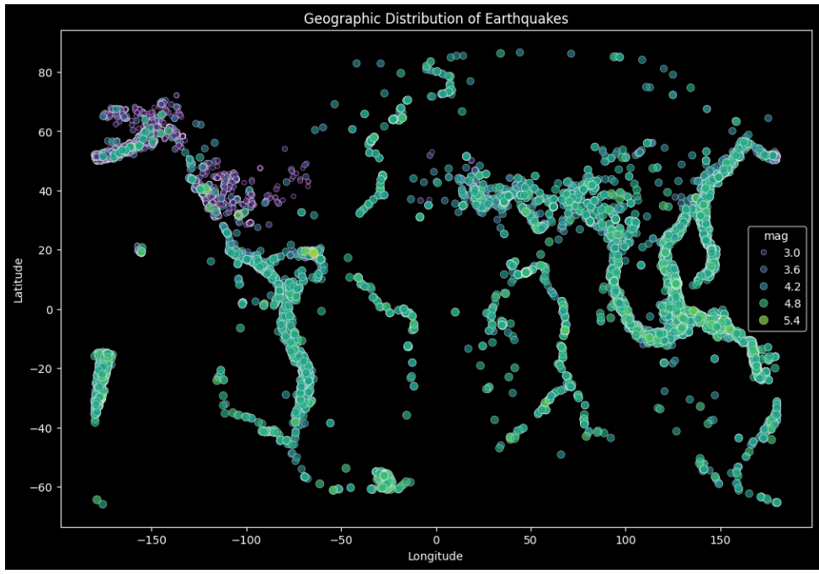
Geographic Distribution of Earthquakes
The graph creates a scatter plot using Seaborn to visualize the geographic distribution of earthquakes. The x and y axes represent longitude and latitude, respectively. The color and size of each point are determined by the magnitude of the earthquake. The plot has a specified color palette, transparency, and size, and it includes a title and axis labels.

Slide 14
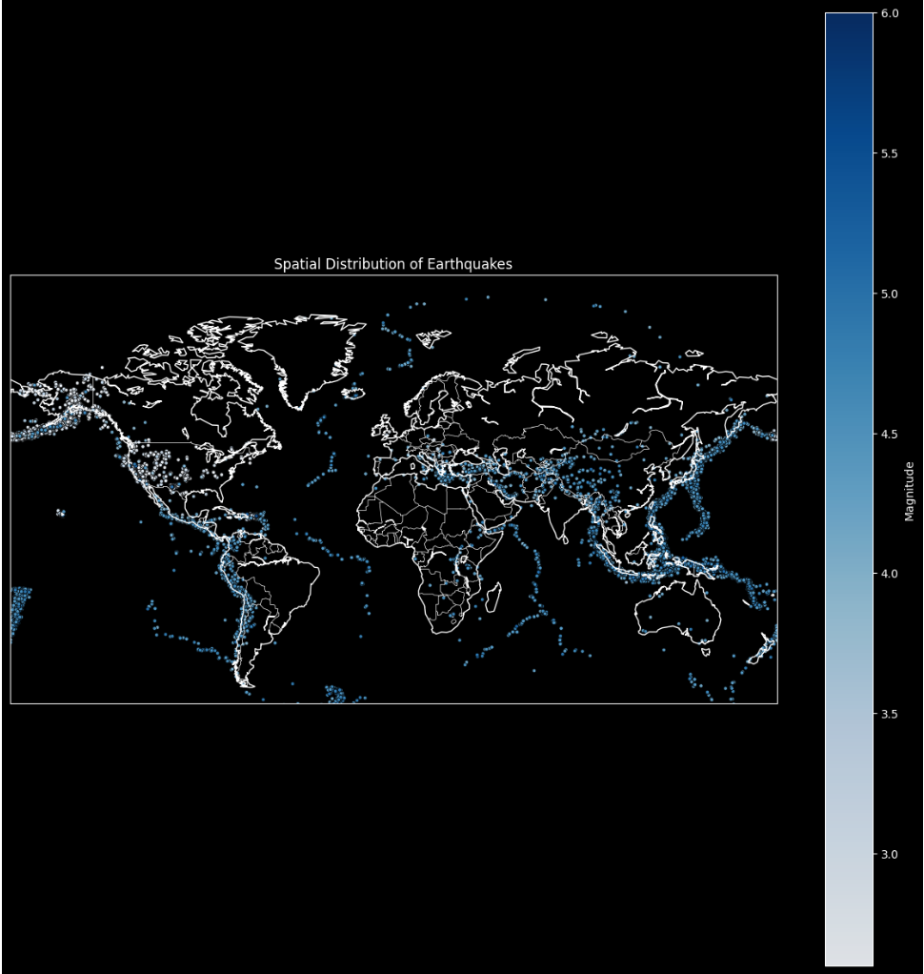
Spatial Distribution of Earthquakes
This graph shows the spatial distribution of earthquakes. The darker color indicates stronger earthquakes occur. From the graph, we can see that dark colors appear on the boundary of different tectonic plates.

Slide 15
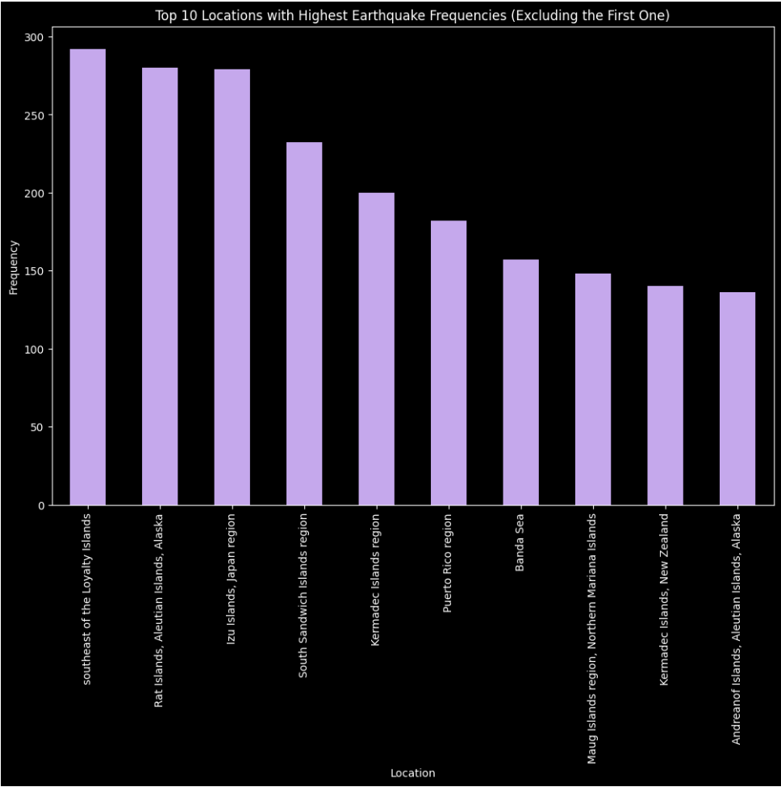
Bar plot of the top N with the highest earthquake frequencies
The output graph displays a bar chart representing the top 10 locations with the highest earthquake frequencies.
The visualization allows for a quick comparison of earthquake frequencies across different locations, providing insights into geographic hotspots for earthquake activity.

Slide 16
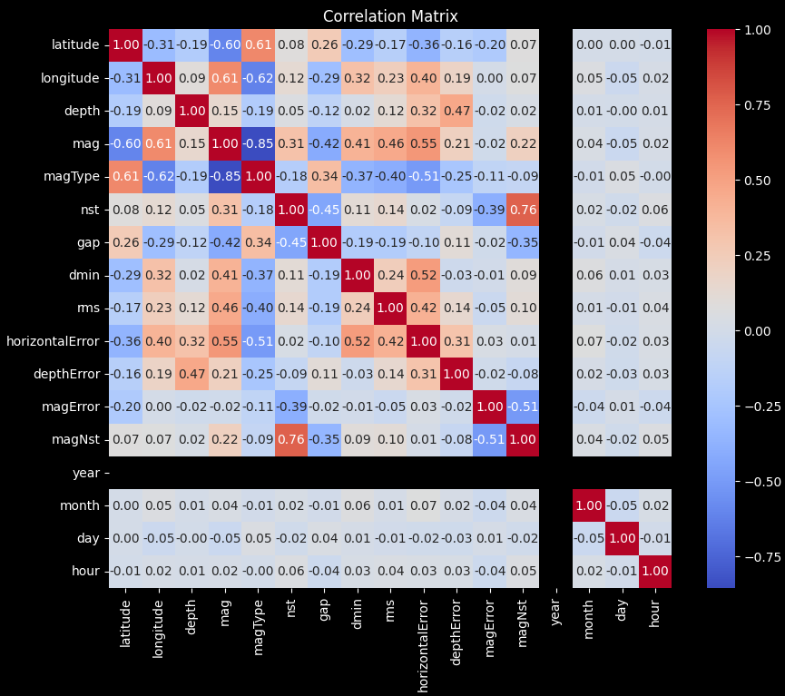
Correlation matrix between different variables
This heatmap shows the correlation between different numeric variables.
High Positive Correlation: Red colored cells with values close to 1 indicate a strong positive correlation. Variables with high positive correlation tend to increase or decrease together.
High Negative Correlation: Blue colored cells with values close to -1 indicate a strong negative correlation. Variables with high negative correlation move in opposite directions.
Low or No Correlation: Cells with values close to 0 suggest a weak or no linear correlation between the corresponding variables.

Slide 17
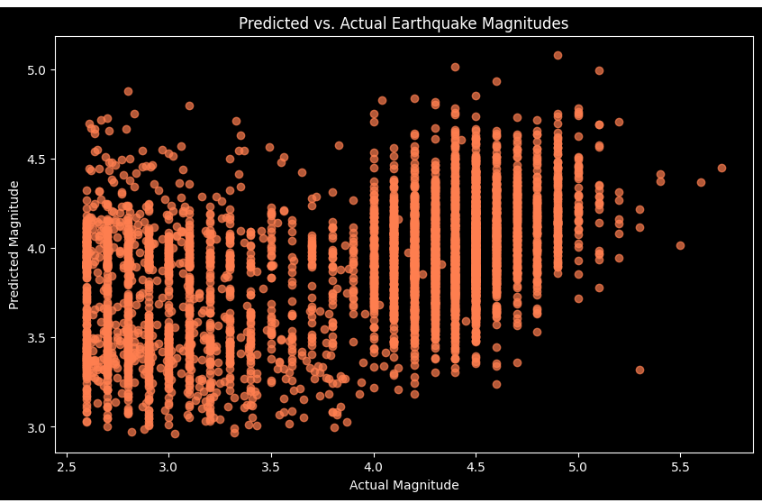
Advanced Analysis
The output graph visualizes the predicted versus actual earthquake magnitudes based on a linear regression model.
Each point on the scatter plot represents an earthquake instance from the test dataset. The x-axis represents the actual magnitudes (y_test), while the y-axis represents the predicted magnitudes (predictions) by the linear regression model.

Slide 18
Advanced Analysis
The MSE is calculated. MSE=0.45649. : The MSE is a measure of the average squared difference between the actual earthquake magnitudes (y_test) and the predicted magnitudes (predictions) across all instances in the test dataset.
MSE of 0.45649 is relatively small. MSE values close to zero indicate a good fit, meaning that the model's predictions are close to the actual magnitudes.

Slide 19
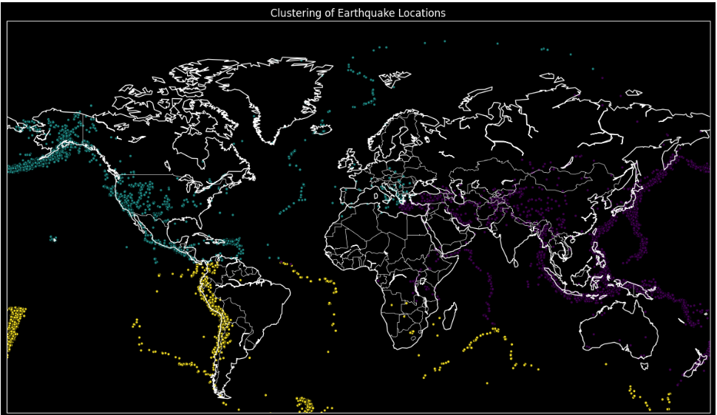
Clustering Earthquake Locations
The scatter plot on the map shows the geographical distribution of earthquakes. Each point represents an earthquake location, and the points are color-coded based on the assigned cluster.
The KMeans algorithm divides the earthquake locations into clusters, with each cluster represented by a distinct color. The cluster centers are determined by the algorithm based on the geographical coordinates (latitude and longitude) of the earthquakes.

Slide 20
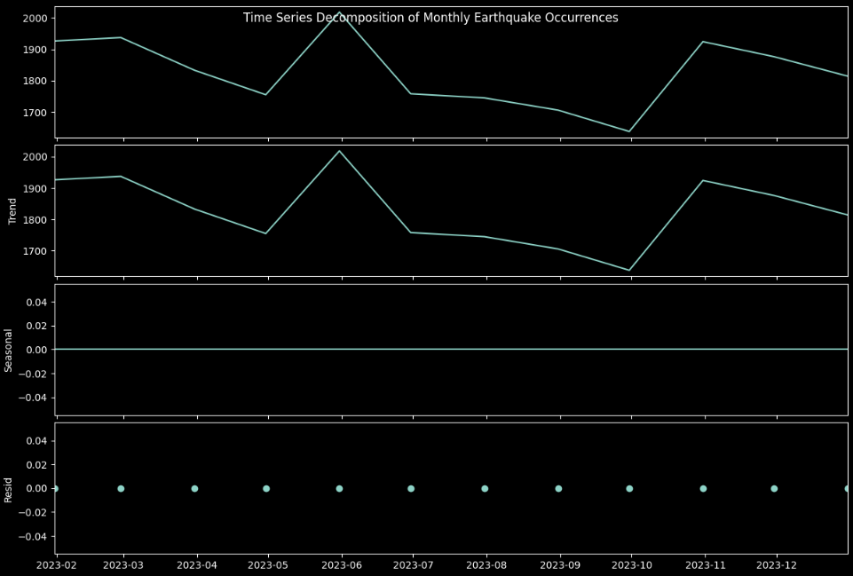
Time Series Decomposition
Monthly earthquake occurrences
First Subplot: This is the original time series data showing the monthly earthquake occurrences. It includes the overall trend, seasonality, and any random fluctuations.
Trend Component (Second Subplot): This component represents the long-term trend or pattern in the data. It shows whether the monthly earthquake occurrences are generally increasing, decreasing, or remaining relatively constant over time.

Slide 21
Time Series Decomposition
Seasonal Component (Third Subplot): In this case, since the period is set to 1 (no seasonality), this component is flat.
Residuals (Bottom Subplot): These are the remaining fluctuations in the data after removing the trend and seasonal components. Residuals represent the random noise or irregularities that are not accounted for by the trend and seasonality.

Slide 22

CONCLUSION
Visualization is crucial for the earthquake dataset for several reasons:
Pattern Recognition
Geographic Insights
Magnitude Distribution
Time Series Analysis
Cluster Analysis
Predictive Modeling Assessment
Identification of Outliers

Slide 23
Reference
https://www.kaggle.com/datasets/mustafakeser4/earthquakes-2023-global/data

Slide 24
THANK YOU!

